Slide 1
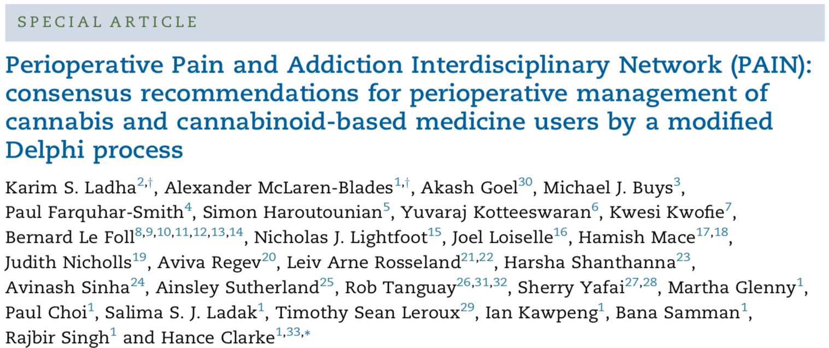
This article reviews available literature to make recommendations for perioperative management of patients who use cannabis
The authors make both major and minor recommendations about what factors are most important to consider for patient care

Slide 2
Main point:
The number of regular cannabis users has significantly increased in recent years.
Recent data suggests that cannabis use can impact perioperative outcomes.
Cannabis has been implicated in effects on a number of organ systems, including gastrointestinal, respiratory, cardiovascular, hematological and central nervous systems.
However, there has been no comprehensive evaluation of how to best manage surgical patients who are using cannabis.

Slide 3
Results:
The authors reviewed medical literature about the perioperative care of patients who use cannabis and surveyed a panel of 17 experts to independently identify and evaluate relevant perioperative care measures.
The elements identified in this assessment were then discussed among the experts and sent to 4 independent reviewers (a surgeon, a nurse practitioner, and two patients). The feedback from the experts and the reviewers were used to finalize the recommendations.
The recommendations are intended for professionals involved in the perioperative care of surgical patients; such as anesthesiologists, surgeons, pharmacists, nurse practitioners and nurses.
Major recommendations: emphasizing the importance of knowing the history of a patient’s cannabis use, quantifying their use, and ensuring that they are in contact with an approved cannabis prescriber.
During preoperative assessments, patients should be routinely screened for cannabis consumption.
Cannabis prescribers should be included in discharge planning, especially among patients on higher doses of cannabis or those who’s cannabis dose has been stopped, changed or substituted. This will ensure that patients are following up with informed healthcare providers.

Slide 4
Results:
Minor recommendations: considerations for weaning a patient off of cannabis prior to surgery, additional or alternative prophylaxis for postoperative nausea and vomiting, and additional attention to monitoring and maintaining anesthetic depth.
Weaning patients from cannabis use should be considered if there is more than 7 days until surgery. Weaning should not be considered 24hrs or less before surgery
Cannabis is acknowledged as useful in managing nausea and vomiting in some situations. However, some patients can develop severe cyclic nausea and vomiting due to cannabinoid hyperemesis syndrome or can develop nausea associated with cannabis withdrawal syndrome and traditional anti-emetics are generally not very effective in these patients.
Research suggests that patients using cannabis may need more anesthetic to reach an adequate depth of anesthesia.
Discussion of perioperative cannabis management would be recommended if patients report a history of significant cannabis consumption, of greater than 1.5 g/day of inhaled cannabis, 300 mg/day of CBD oil, 20 mg/day of THC oil or use of an unknown/unquantified cannabis product more than 2-3 times/day.

Slide 5
Conclusions:
These authors report that it is necessary to consider a patients cannabis use when managing perioperative patient care.
It is most important to establish a patient’s history of cannabis use (frequency and quantity), and to ensure that discharged patients are in contact with an authorized cannabis prescriber.
Secondary to these are recommendations to consider weaning patients from cannabis, additional or alternative prophylaxis for nausea and vomiting and particular attention to monitoring and maintaining anesthesia during surgery.
The authors note that there were not a large number of studies available from which to draw data on this topic, so more research is needed to expand on all of these recommendations

